Slide 1
Greedy Method

Slide 2
0/1 Knapsack Problem
All the greedy criterion fails to give optimum solution for the 0/1 knapsack problem.

Slide 3
Fractional Knapsack Problem
profit by density greedy criterion gives optimum solution for fractional knapsack problem

Slide 4
Single Source Shortest Path Problem: Dijkstra’s Algorithm
The problem of finding shortest paths from a source vertex s to all other vertices in the graph.
i/p: weighted graph G = (E, V) and source vertex s
o/p: shortest path from source vertex s to all other vertices
Works for :
both directed and undirected graph
All edges must have non-negative weights ?!

Slide 5
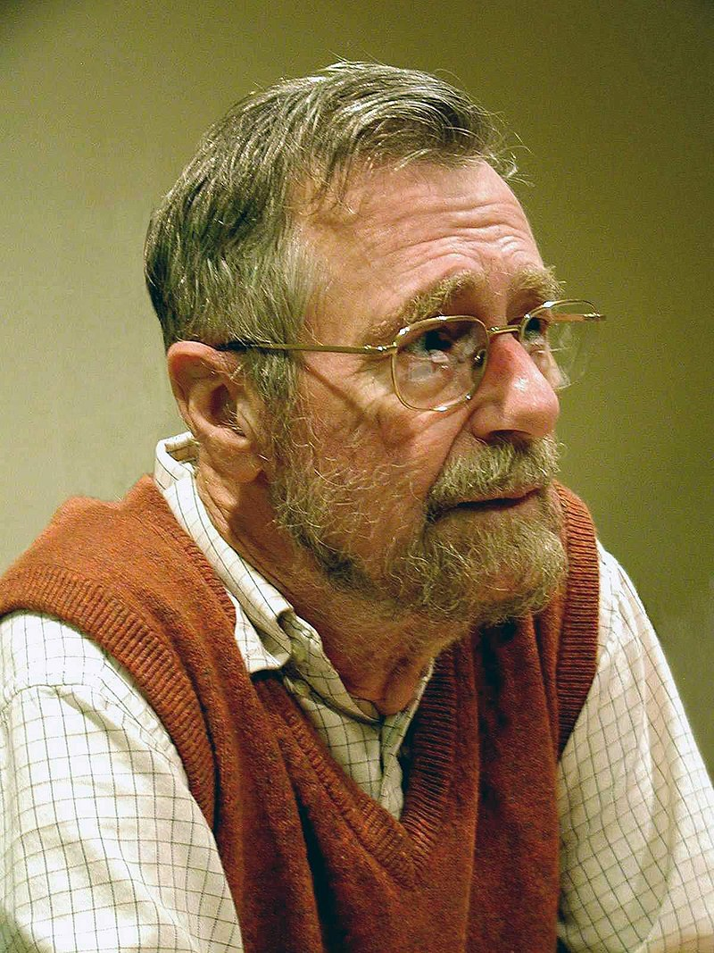
Born | 11 May 1930 Rotterdam, Netherlands
Died | 6 August 2002 (aged 72) Nuenen, Netherlands
Citizenship | Netherlands
Education | Leiden University (B.S., M.S.) University of Amsterdam (Ph.D.)
Known for | See below
Spouse(s) | Maria (Ria) C. Debets
Awards | SIGCSE Outstanding Contribution (1989) Turing Award (1972) ACM Fellow (1994) Dijkstra Prize (2002)
Scientific career
Fields | Computer science Theoretical computer science
Institutions | Mathematisch Centrum Eindhoven University of Technology Burroughs Corporation University of Texas at Austin
Edsger W. Dijkstra - Wikipedia

Slide 6
Dijkstra’s Algorithm
Initialize D[s] = 0 and D[v]= ꚙ for all v in V – {s} and Q=V (Q, the queue initially contains all vertices) Visited[v] = 0 and path[v] = -1 and path[s]=s
While (Q is not empty)
{
delete a min distance vertex u (say) from Q
Visited [u]=1
for (all un-visited neighbors v of u)
{
if (D[v] > D[u] + w (u, v))
{
D[v] = D[u] + w (u, v)
path[v]= u
}
}
}

Slide 7
Trace Dijkstra’s algorithm for the following graph

Slide 8
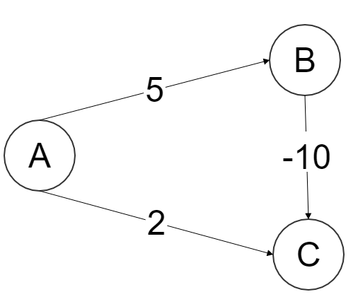

Dijkstra’s Algorithm won’t work if graph has negative edge weights
If cost of every edge is increased by 1, whether the shortest path remains same?!

Slide 9
Topological Sort

Slide 10
Example
Activity on Vertex (AOV) network

Slide 11
Algorithm: Topological Sort

Slide 12
Example: Topological Sort

Slide 13
Time complexity of Topological Sort

Slide 14
Bipartite Cover Problem
An undirected graph G is said to be Bipartite graph if its vertices can be partitioned in to sets A and B such that no edge in the graph connects two vertices in the same set.
A’ subset of A, is said to cover the set B iff every vertex in B is connected to at least one vertex of A’
A’ is said to be minimum cover if A has no subset of smaller size that covers B
The problem of finding minimum cover in a Bipartite graph is Bipartite cover problem

Slide 16
Pseudocode
O(n)
O(n²) if adjacency matrix is used
O(n)
Complexity O(n²)

Slide 17
Minimum Cost Spanning Tree
Select n-1 edges from given n-vertex graph such that the selected edges form least cost spanning tree.
There are three different greedy strategies to select n-1 edges resulting in three different algorithms for Minimum cost spanning tree
Kruskal’s
Prim’s
Sollin’s

Slide 18
Identify the number of distinct minimum spanning trees for the weighted graph given below:

Slide 19
Kruskal’s Algorithm
Greedy criterion: From the remaining edges, select a least cost edge that does not result in a cycle when added to a set of already selected edges.

Slide 20
Kruskal’s Algorithm

Slide 21
Trace Kruskal’s Algorithm for the graph given below:

Slide 22
Kruskal’s Algorithm
T = ∅
foreach v ∈ V: MAKE-SET(v)
foreach (u, v) in E ordered by weight(u, v), increasing:
if FIND-SET(u) ≠ FIND-SET(v):
T = T ∪ {(u, v)}
UNION(u, v)
return A
Source: Kruskal's Algorithm – Minimum Spanning Tree (MST) - Complete Java Implementation | TutorialHorizon

Slide 23
Prim’s Algorithm

Slide 24
Prim’s Algroithm

Slide 25
Prim’s Algorithm
1. mst[] to keep track to vertices included in MST.
2. key[s]=0 and key[v]= +∞ for all v in V-{1}, s is the start vertex
3. Repeat the following steps until all vertices are processed
Pick the vertex u which is not in mst[] and has minimum key.
Add vertex u to mst[].
For adjacent vertex v, if v is not in mst[] and edge u-v weight is less than the key of vertex v, key[v] then update the key[v]= edge u-v weight.
4. Return mst[].
Source for algo and example: Prim’s Algorithm - Minimum Spanning Tree (MST) | TutorialHorizon

Slide 26
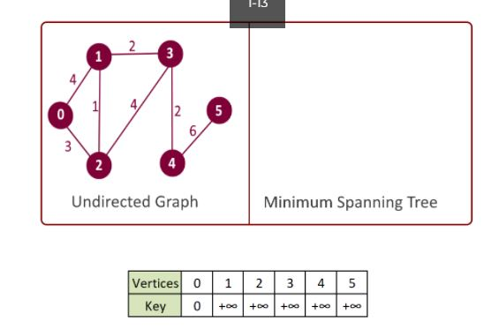
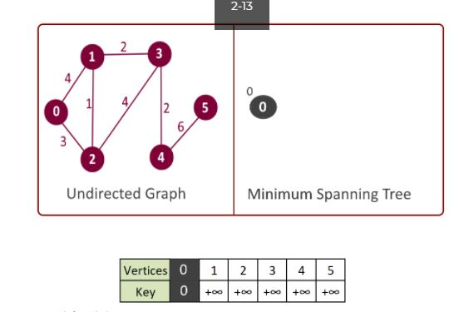
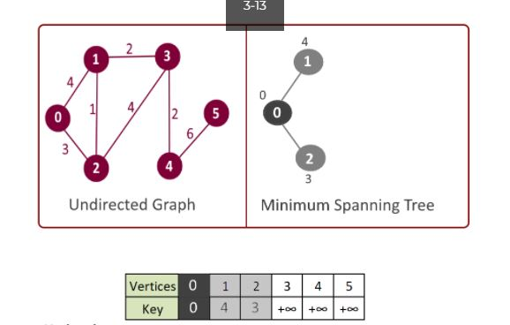
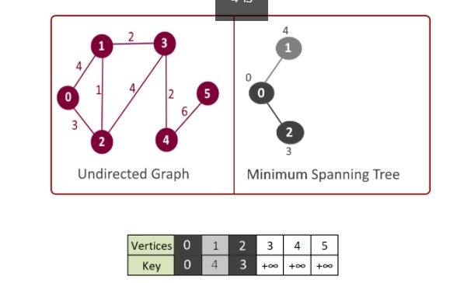

Slide 27
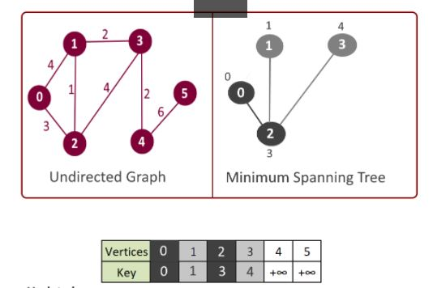
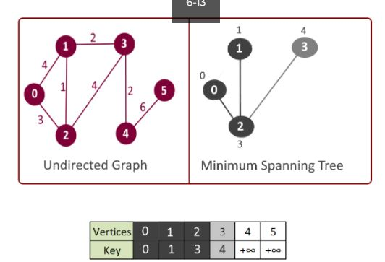
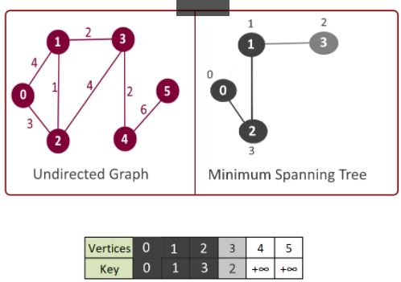
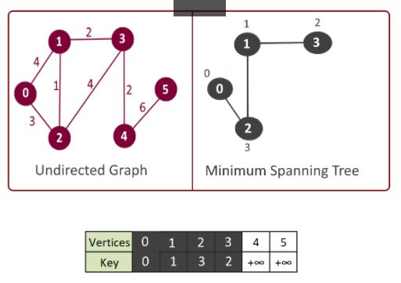

Slide 28
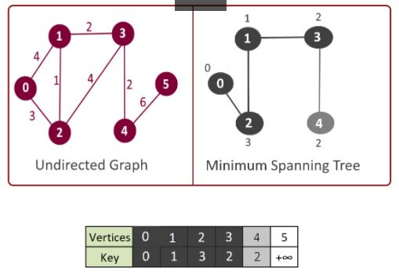
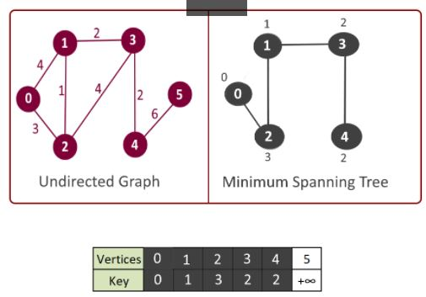
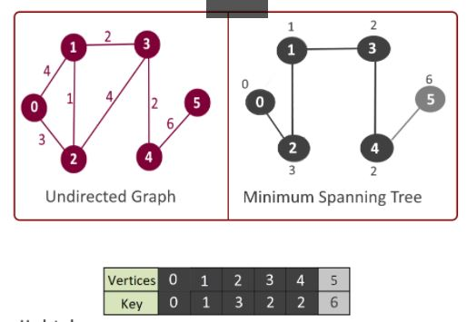
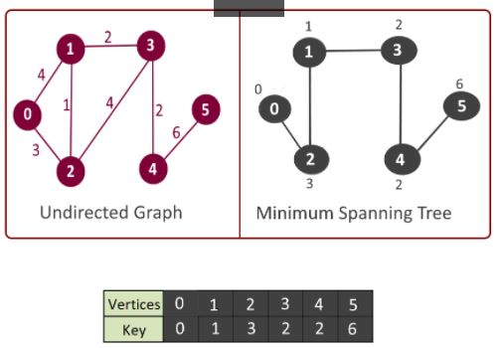

Slide 29
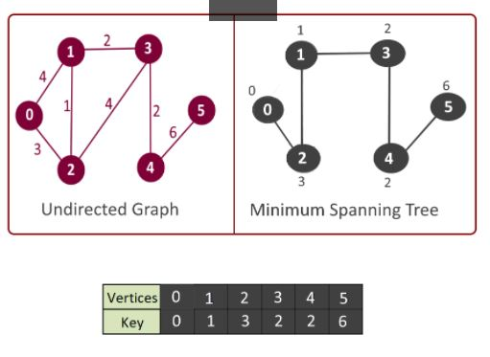

Slide 30
Trace Prim’s Algorithm for the graph given below:

Slide 31
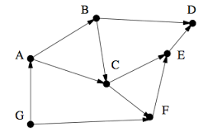
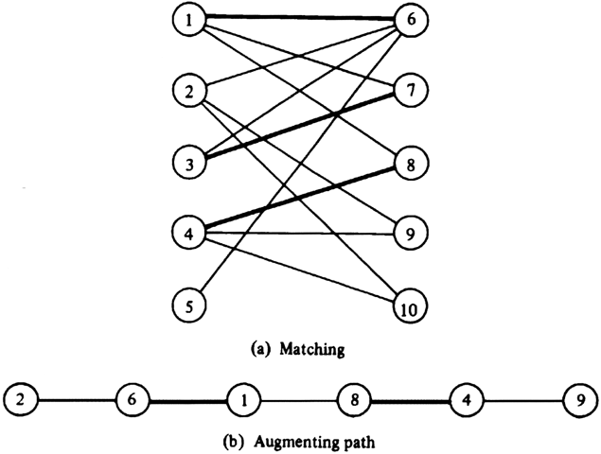
DAA-ICT 2257 (Tutorial) 25-03-2022
For all the questions trace the algorithm and show the steps clearly. Also specify the time complexity of algorithm used.
Fig 1 Fig 2
Obtain topological sequence for the graph given in Fig 1. using greedy technique.
Obtain Bipartite cover for the graph given in Fig 2. using greedy technique.

Slide 32
References
Microsoft PowerPoint - Lecture20 (washington.edu)
Sartaj Sahani, Data Structures, Algorithms and Applications in C++ (2e), Silicon Press, 2005.
Prim’s Algorithm - Minimum Spanning Tree (MST) | TutorialHorizon
Kruskal's Algorithm – Minimum Spanning Tree (MST) - Complete Java Implementation | TutorialHorizon

Slide 33
THANK YOU

